Slide 1
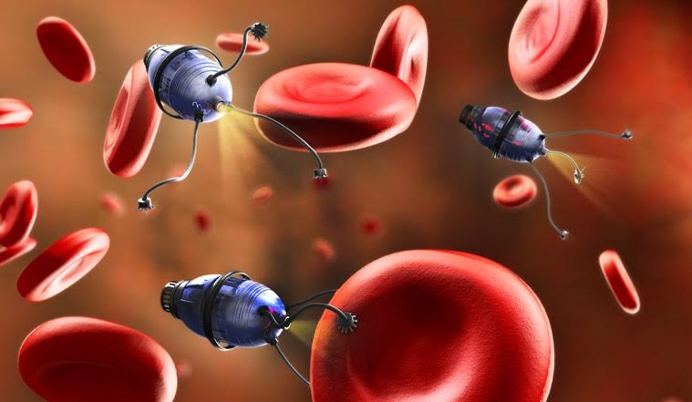
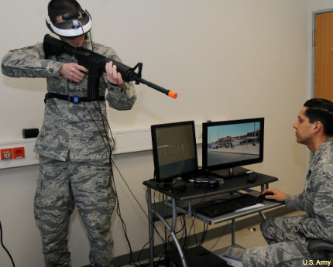
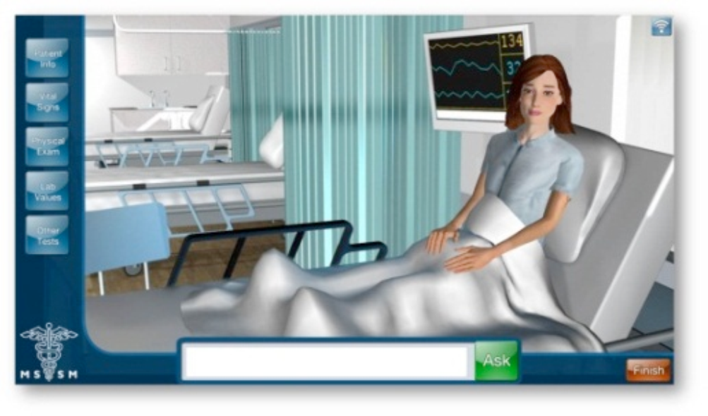
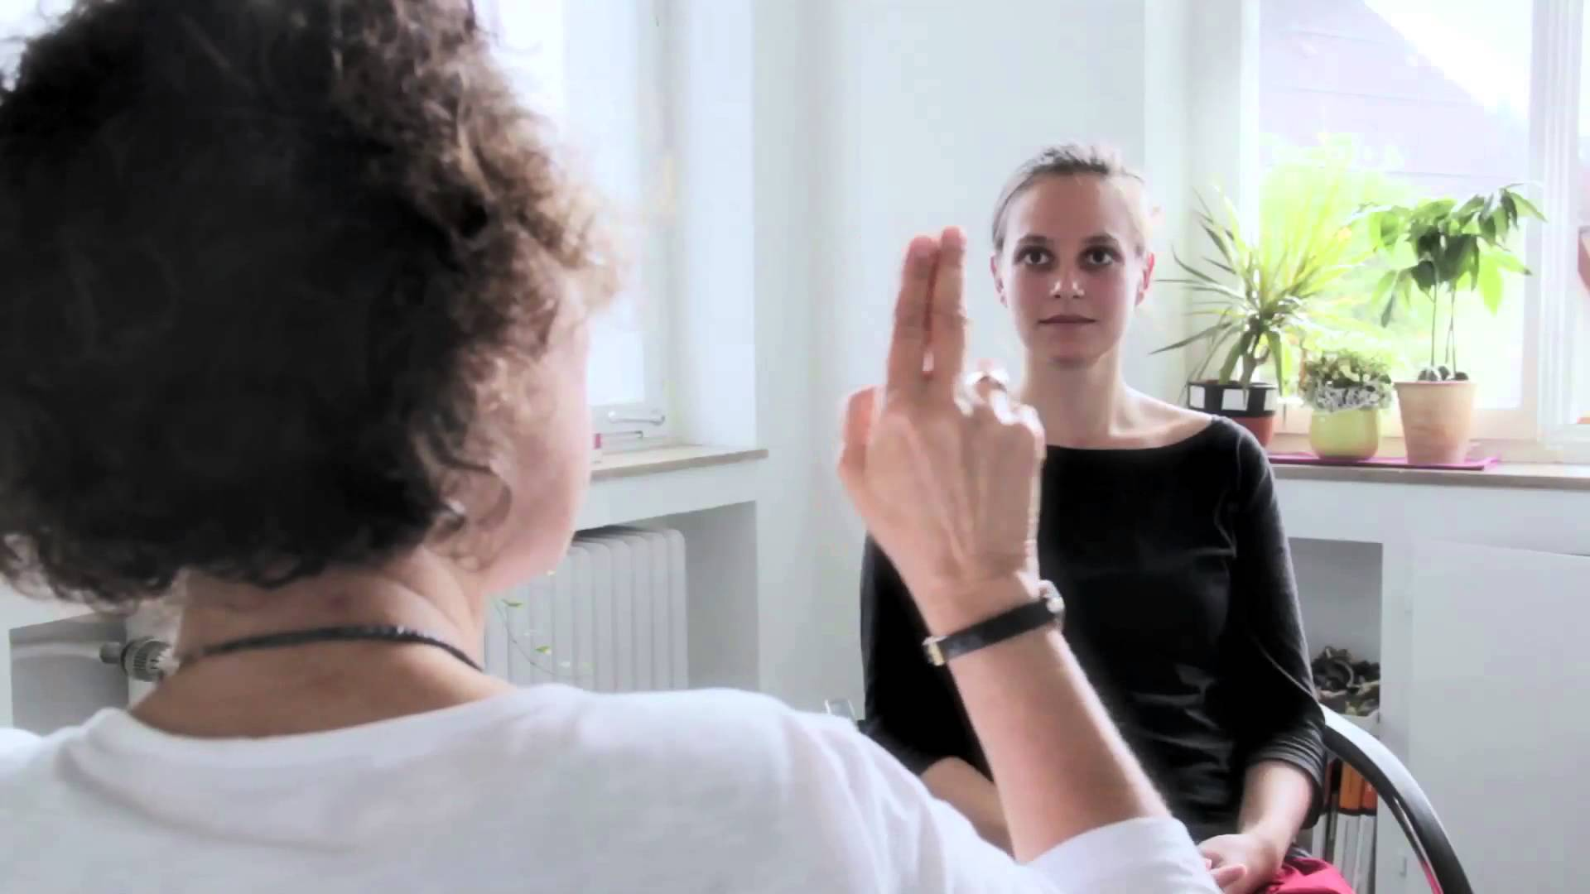
History of Anesthesiology
Anesthesiology and modeling and simulation started the 1980s with computerized anesthesiology mannequins by Michael Good and David Gaba. These mannequins outputted physiological responses and were used in live OR simulations to train doctors. These mannequins had unrealistic designs and wore out.
Howard Schwid, built the Anesthesia Simulator Consultant (ASC), a learning program that had goals and tasks for the doctors to complete with various factors. Users didn’t gain operation room experience or experience injecting medication.
McDonald, Rosenberg and Stredney (1995) created a virtual reality program to train Anesthesiologists on the task of epidural procedures. This allowed hands-on training but were not constructive simulations
Human Error in Anesthesiology
Harry Fran Skidmore
Patricia Bocklemen
11/19/18
Statement of Purpose
The purpose of this poster is to explain the history, the state of the topic, and future research of how modeling and simulation is used to lower anesthesiology human errors.
State of the Field
Anesthesiology human error is addressed using the same, but improved methods.
Live simulation training is used to reduce errors, and allow mistakes. But fail to generate emotions anesthesiologists might experience in a real scenarios
Mannequins and 3d models, though costly, target specific skill training.
VR now are constructive simulations that involves virtual environments with avatars.
Participants often report the simulation was unrealistic and made them uncomfortable.
Future Directions
Nanotechnology will allow anesthesia to be administered to the brain or specific areas.
Is still untested and ethical issues will hold up research.
Mental illness from trauma may increase chances of medication errors
One of the most effective forms of psychotherapy is Eye Movement desensitization and reprocessing
A possible method of treatment is combining EMDR with Simulation to create images and further help treatment.
Types of Human Error
Types of Medication Error in Anesthesiology
Possible Effects of Medication Errors
Syringe Swop | The wrong syringe is chosen due to not reading the label.
Syringe Label Error | The syringe is improperly labeled with the medication it contains.
Pharmaceutical Dilution Error | The incorrect dilution of the drug is used.
Administration Route errors | The drugs are given through the incorrect method (e.g. given through injection rather then intravenously.)
Communication Medication Errors | Improper communication results in the wrong drug being administered. Could be caused by factors such accents, different trainings, familiarity with terminology, or simply similar sounding drug names
Wrong Dosage Error | Wrong dosage of medicine is given.
Slips | Errors that occur during skill based, automatic routine behaviors. (e.g. A driver does not put on the turn signal before changing lanes.)
Lapses | Memory errors that occur in procedures. (e.g. Someone is baking a cake and forgets to add an ingredient to a recipe)
Mistakes | Errors due to lack of knowledge, or misapplying rules to situations that don’t fit. (e.g. someone gives the wrong medicine, either due to lack of knowledge of the patient’s medical history or due to some rule about giving the drug for similar situations.)
Low Blood Pressure | Lack of oxygen to the brain, causing brain damage.
Irregular Heart Rhythm | Possibly could cause stroke, heart stopping or even heart attack
Breathing issues | Can cause damage to lungs, chronic breathing disorders to develop after surgery, death
Intraoperation Awareness | Patient feels the surgery and is aware of what is happening but is not conscious enough to move or speak.
Notes:
Poster that was presented for a project on Human Error in Anesthesiology. It explained the state of how modeling and simulation is currently used in training for Anesthesiology to lower human error. It further goes on to describe the type of human errrors that occur and how future directions in nano technology may lower them. Future use of simulation in EMDR therapy may also help decerase mental illness that may occur from the errors that may develop.

